Slide 1
Human Resources Onboarding

Slide 2
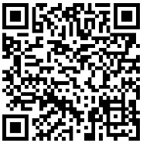
Productivity Board Program
What is it?
The Productivity Board incentivizes state employees to help our government operate more efficiently. The Productivity Board was reinstated by the State Legislature in 2023.
The program encourages employees to submit suggestions under two main categories:
The Employee Suggestion Program, which awards
10% of net savings.
The Teamwork Incentive Program, which awards up to 25% of net savings.
Individuals can be awarded up to $10,000.
Please visit our website or scan the QR code to learn more.
https://sos.wa.gov/productivity-board

